Slide 1
Tree contd…

Slide 2
Binary Tree
Binary Tree is a special type of generic tree in which, each node can have at most two children. Binary tree is generally partitioned into three disjoint subsets.
Root of the node
left sub-tree which is also a binary tree.
Right binary sub-tree

Slide 3
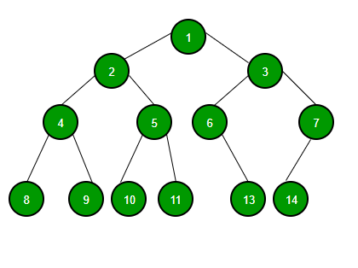
Binary Tree

Slide 4
TYPES OF BINARY TREE

Slide 5
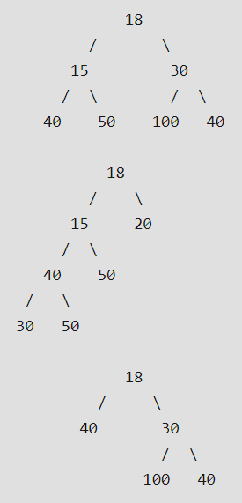
Full Binary Tree A Binary Tree is full if every node has 0 or 2 children. We can also say a full binary tree is a binary tree in which all nodes except leaves have two children.
In Full Binary, number of leaf nodes is number of internal nodes plus 1 L = I + 1 Where L = Number of leaf nodes, I = Number of internal nodes

Slide 6
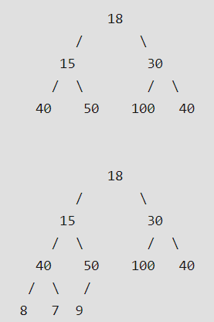
Complete Binary Tree: A Binary Tree is complete Binary Tree if all levels are completely filled except possibly the last level and the last level has all keys as left as possible

Slide 7
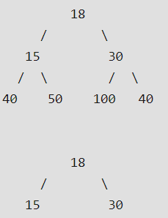
Perfect Binary Tree A Binary tree is Perfect Binary Tree in which all internal nodes have two children and all leaves are at the same level.
A Perfect Binary Tree of height h (where height is the number of nodes on the path from the root to leaf) has 2^{h} – 1 node.

Slide 8
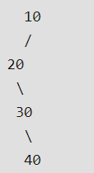
A degenerate tree A Tree where every internal node has one child. Such trees are performance-wise same as linked list.

Slide 9
Tree Traversal
Inorder Traversal
Left
Root
Right
Post order traversal
Left
Right
Root
PreorderTraversal
Root
Left
Right

Slide 10
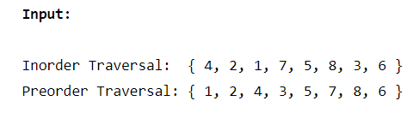
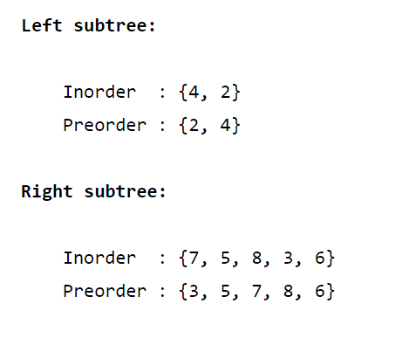
Construction of Binary Tree

Slide 11
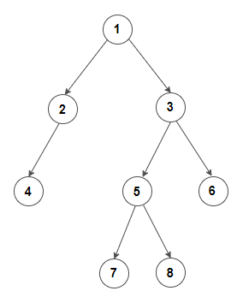
Construction of Binary Tree
Left
Inorder: {7,5,8,}
Preorder: {5,7,8}
Right
Inorder: {6}
Preorder: {6}
Left
Inorder: {4}
Preorder: {4}
Right
null
Left
Inorder: {7}
Preorder: {7}
Right
Inorder: {8}
Preorder: {8}

Slide 12
Construction of Binary Tree

Slide 13
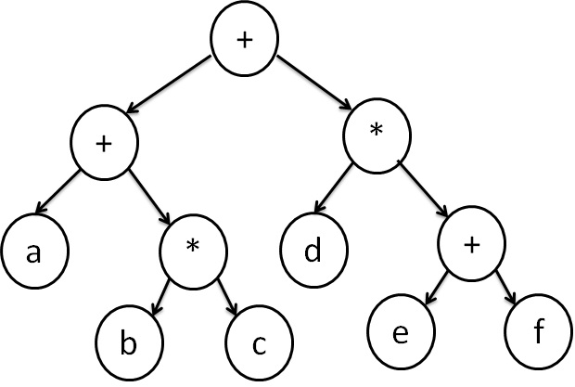
Expression Tree
Expression Tree is used to represent expressions.
There are different types of expression formats:

Slide 14
Prefix expression
Infix expression and
Postfix expression
Expression Tree is a special kind of binary tree with the following properties:
Each leaf is an operand.
The root and internal nodes are operators.
Subtrees are subexpressions with the root being an operator.

Slide 15
Traversal Techniques
There are 3 standard traversal techniques to represent the 3 different expression formats.
Inorder Traversal
We can produce an infix expression by
recursively printing out the left expression,
then printing out the root, and
recursively printing out right expression.

Slide 16
Postorder Traversal
The postfix expression can be evaluated by
recursively printing out the left expression,
right expression and
then root
Preorder Traversal
We can also evaluate prefix expression by:
printing out the root and
then recursively print out the left and
right expression.

Slide 17
Infix expression: (a+(b*c))+(d*(e + f))
Postfix Expression: a b c * + d e f + * +
Prefix Expression: + + a * b c * d + e f

Slide 18
Construction of Expression Tree
Following are the step to construct an postfix expression tree:
Read one symbol at a time from the postfix expression.
Check if the symbol is an operand or operator.
If the symbol is an operand, create a one node tree and pushed a pointer onto a stack
If the symbol is an operator, pop two pointer from the stack namely T₁ & T₂ and form a new tree with root as the operator, T₁ & T₂ as a left and right child
A pointer to this new tree is pushed onto the stack

Slide 19
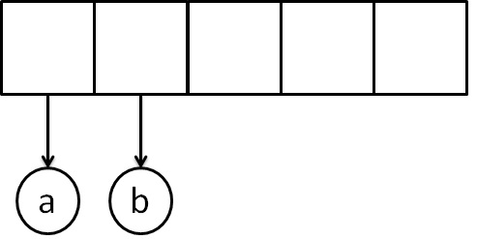
Example
The input is:
a b + c *
The first two symbols are operands, we create one-node tree and push a pointer to them onto the stack.

Slide 20
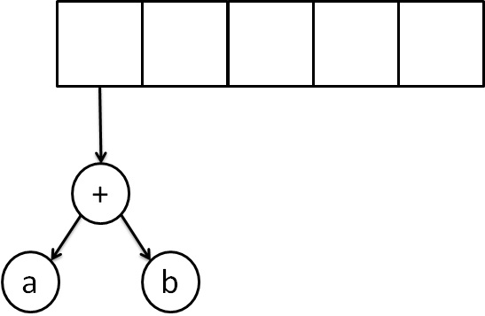
Next, read a'+' symbol, so two pointers to tree are popped,a new tree is formed and push a pointer to it onto the stack.

Slide 21
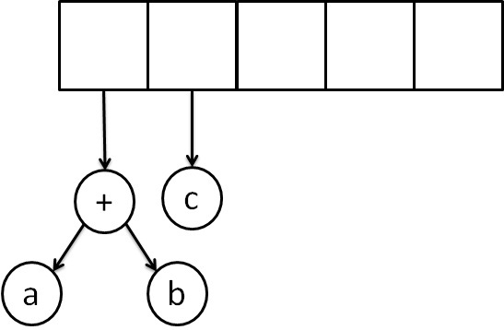
Next, 'c' is read, we create one node tree and push a pointer to it onto the stack.

Slide 22
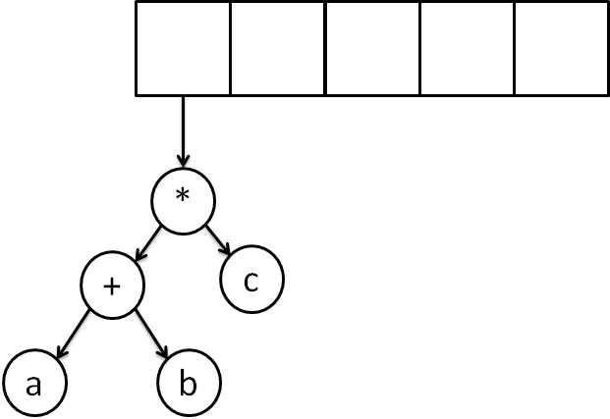
Finally, the last symbol is read ' * ', we pop two tree pointers and form a new tree with a, ' * ' as root, and a pointer to the final tree remains on the stack.

Slide 23
Thank You

